Slide 1
FACE RECOGNITION BASED ATTENDANCE SYSTEM
PROJECT GUIDE
Mr .B .RAVI
ASSISTANT PROFESSOR
PROJECT TEAM
D.BALA SUBRAHMANYAM (19X41A0413)
G.GAYATHRI (20X45A0404)
N.MUKUNDA PRIYA (19X41A0433)
P.SRI LAKSHMI NADH (19X41A0441)

Slide 2
CONTENTS
ABSTRACT
INTRODUCTION
HISTORY OF IOT
RASPBERRY PI
OPERATING SYSTEM OF RASPBERRY PI
VNC VIEWER
PROGRAMMING LANGUAGE
MODULES USED IN PROGRAM
THINGSPEAK
APPLICATIONS
LITERATURE REVIEW
PROPOSED MODEL
ADVANTAGES AND DISADVANTAGES
WORKING

Slide 3
ABSTRACT
This project aims to take attendance using face recognition. The captured image from the camera are compared with the stored data . If the captured image is matched with the stored image then the system will give attendance , if it mismatch it will show unknown. The stored data consists of images of the student with different postures . Face recognition based attendance system is smart and secure than compared to biometric.

Slide 4
INTRODUCTION
A facial recognition attendance system uses facial recognition technology to identify and verify a person using the person's facial features and automatically mark attendance.
The software can be used for different groups of people such as employees. The system records and stores the data in real-time.
Facial recognition is the most feasible option available in the current situation for organizations to make employee attendance and visitor entry contactless.

Slide 5
INTERNET OF THINGS
The term Internet of Things was coined in 1999 by the computer scientist Kevin Ashton.
Over the past few years, IoT has become one of the most important technologies of the 21st century.
Now that we can connect everyday objects like kitchen appliances, cars, thermostats, baby monitors to the internet via embedded devices, seamless communication is possible between people, processes, and things.
By means of low-cost computing, the cloud, big data, analytics, and mobile technologies, physical things can share and collect data with minimal human intervention.
In this hyperconnected world, digital systems can record, monitor, and adjust each interaction between connected things.

Slide 6
RASPBERRY PI
The Raspberry Pi is equipped with a quad-core 64-bit Broadcom BCM2837 ARM Cortex-A53 SoC processor.
Which means the new Raspberry Pi 3 can be used for office applications and web browsing.
The great innovation in this third version is undoubtedly the addition of a WIFI chip and Bluetooth . This not only saves space but also frees up more USB ports for connecting other devices.

Slide 7
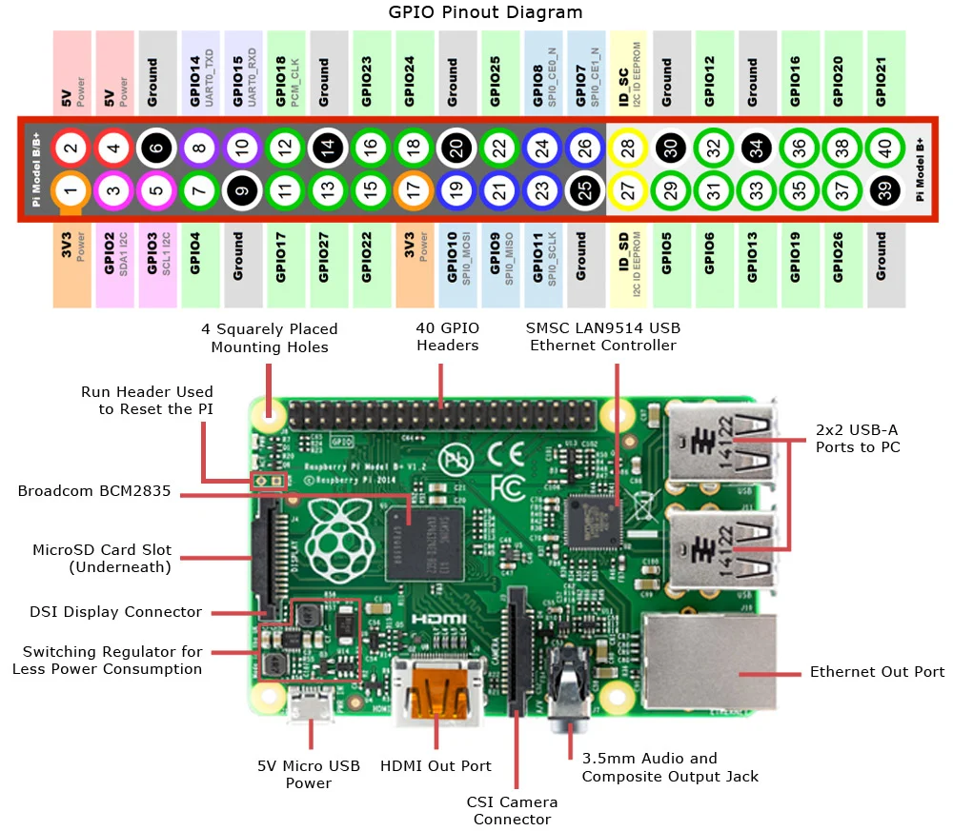

Slide 8
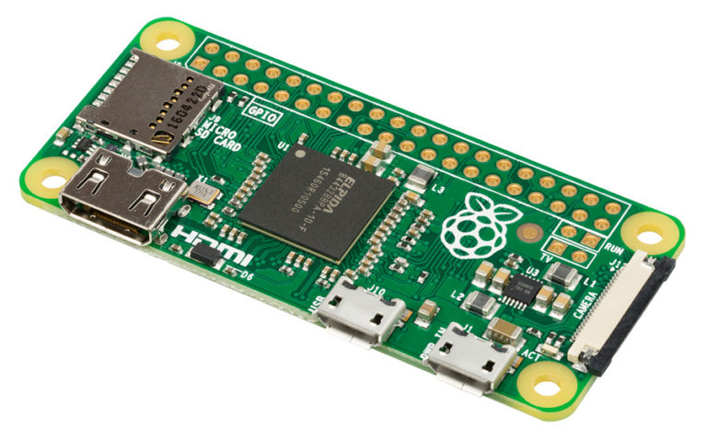
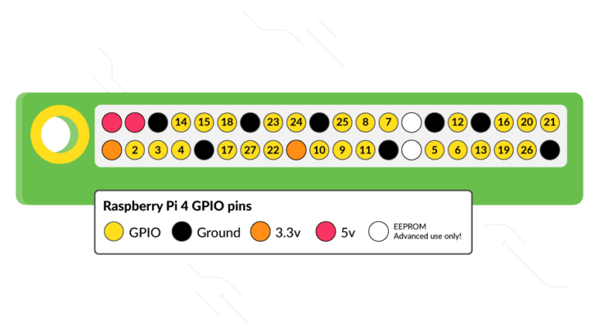
Raspberry pi Layout
GPIO pins layout

Slide 9
Pins of Raspberry Pi
Most models of the Raspberry Pi have a 40-pin header, as shown in the image above. Of the 40 pins, 26 are GPIO pins and the others are power or ground pins.
Any of the GPIO pins can be designated as an input or output pin and used for a wide range of purposes; whether it is turning on an LED, driving a motor, or sending data to another device, the possibilities are almost endless.
To get started you need a Raspberry Pi Model B+, a 5V USB power supply of at least 2 amps with a micro USB cable, any standard USB keyboard and mouse, an HDMI cable and monitor/TV for display, and a micro SD card with the operating system pre-installed.

Slide 10
OPERATING SYSTEM OF RASPBERRY PI
Raspberry Pi OS formerly Raspbian is a Unix-like operating system based on the Debian Linux distribution for the Raspberry Pi family of compact single-board computers. First developed independently in 2012.
Raspbian is a free operating system based on Debian optimized for the Raspberry Pi hardware. An operating system is the set of basic programs and utilities that make your Raspberry Pi run.

Slide 11
VNC VIEWER VNC VIEWER
Virtual Network Computing (VNC) is a graphical desktop-sharing system that uses the Remote Frame Buffer protocol (RFB) to remotely control another computer .It transmits the keyboard and mouse input from one computer to another, relaying the graphical-screen updates, over a network.
VNC is platform-independent. Multiple clients may connect to a VNC server at the same time.
The VNC client is the program that represents the screen data originating from the server, receives updates from it.

Slide 12
PROGRAMMING LANGUAGE
Python is an interpreted, interactive, object-oriented programming language.
It incorporates modules, exceptions, dynamic typing, very high level dynamic data types, and classes.
It supports multiple programming paradigms beyond object-oriented programming, such as procedural and functional programming.
Python combines remarkable power with very clear syntax. It has interfaces to many system calls and libraries, as well as to various window systems, and is extensible.
Finally, Python is portable: it runs on many Unix variants including Linux and macOS, and on Windows.

Slide 13
LIBRARIES
TKINTER
CV2
SHUTIL
CSV
NUMPY
PIL
PANDAS
URLLIB.REQUEST

Slide 14
THTTTttttttt ThingSpeak
ThingSpeak is an IoT analytics platform service that allows you to aggregate, visualize and analyze live data streams in the cloud.
ThingSpeak provides instant visualizations of data posted by your devices to ThingSpeak.ThingSpeak you can perform online analysis and processing of the data as it comes in.
At the heart of ThingSpeak is a time-series database. ThingSpeak provides users with free time-series data storage in channels. Each channel can include up to eight data fields.

Slide 15
APPLICATIONS
Time & attendance: Face recognition provides quick, efficient and reliable facial recognition, allowing to build highly efficient time and attendance control systems.
Secure authentication: The SDK provides highly reliable biometric identification based on live video recognition with extremely low false positive rates, allowing to build secure authentication systems for multiple applications.
Photo/video search: Highly optimized still and video-based face recognition and identification enables near real-time search through huge photo and video libraries.

Slide 16
LITERATURE REVIEW
HOW IT IS USED : It uses a digital camera to capture the image of the face ,a computer for processing and analysis, and an output device for displaying the identification result. It is straightforward to identify any person from different facial images. The face recognition system is a high speed and reliable technology.
WHY IT IS USED : Facial recognition is that it can prevent unauthorized individuals from entering your office. A facial recognition attendance system can be employed to recognize employees and confirm or refuse access upon entry. This is especially important if your company has inventory or sensitive data.

Slide 17
PROPOSED MODEL
MICRO SD CARD
RASPBERRY PI
(3b)
POWER SUPPLY
PERSONEL COMPUTER
WEB CAMERA
Notes:
I'll exlain about the block diagram of our major project.. The main microprocessor used here is the raspberry pi . Power supply can be directly connected to the current available ..And Micro SD card for storing the data related to the process going on. ESP32 camera is used to recognize and send the data to the processor which could evaluate the picture. Personal computer to control the processor and code to the processor.

Slide 18
ADVANTAGES AND DISADVANTAGES
ADVANTAGES
Face recognition system is socialable because it is convenient.
DISADVANTAGES
Face recognition system should store face data in all angles .

Slide 19
WORKING
Face recognition works by inputting the image into the database before being ready to use. Once the image is processed, it converts it into an analog and gets saved in the database.
These features are recorded and saved in the system. Once the database preserves the image, it is detected by the camera.
To use it successfully, the system must be used correctly. The system must be able to identify the individuals being analyzed. It should be used with individuals who are known, in advance, to be in the database. The system should not be used with people who do not appear in the database.

Slide 20
THANK YOU

